Slide 1

C
E
N
T
R
E
F
B
O
I
R
O
I
I
N
N
Lecture 9
Markov Chain Models Algorithms in Sequence Analysis
T
F
E
O
G
R
R
M
A
A
T
T
I
I
V
C
E
S
V
U

Slide 2
Mentoring Introductory Session
Marlies van Daalen & Anton Feenstra
Tomorrow (Tue 26 Nov) from 13.00-14.00 in NU-4A06.

Slide 3
Algorithms in Sequence Analysis Practical assignment 3: HMM
Hidden Markov Models (involves programming)
Today: ‘Paper’ exercise
From tomorrow: Programming:
Viterbi algorithm
Forward algorithm
Forward-backward (Baum Welch) algorithm

Slide 4
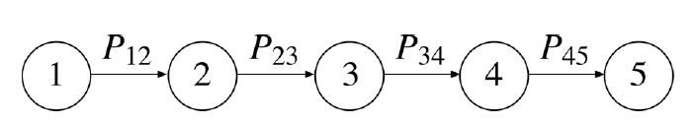
Markov models
A Markov model, also known as Markov chain, describes a sequence of events that occur one after another in a chain.
Each event determines the probability of the next event. A Markov chain can be considered as a process that moves in one direction from one state to the next with a certain probability, which is known as transition probability

Slide 5
A widely used machine learning approach: Markov models
Contents
Statistical background
Markov chain models (1st order, higher order and inhomogeneous models; parameter estimation; classification)
Interpolated Markov models (and back-off models)
Hidden Markov models (forward, backward and Baum-Welch algorithms; model topologies; applications to gene finding and protein family modeling
Biological theme: gene prediction

Slide 6
Statistical theory behind Markov models: Bayesian statistics
For independent events X and Y:
P(X, Y) = P(X) P(Y)
Conditional probabilities - two events are not independent:
P(Y | X) is conditional probability of Y given X
If X and Y are independent:
P(Y | X) = P(Y) and P(X | Y) = P(X)
See Durbin et al., Chapter 1

Slide 7
Statistical theory behind Markov models: Bayesian statistics
Joint probabilities P(X, Y) are then:
P(X, Y) = P(Y | X) P(X) (if X is first) or
P(X, Y) = P(X | Y) P(Y) (if Y is first)
If event X and Y are dependent and we know the conditional or joint probabilities, we get the marginal probability:
P(X) = Σ_{Y} P(X, Y) = Σ_{Y} P(X | Y) P(Y) or
P(Y) = Σ_{X} P(X, Y) = Σ_{X} P(Y | X) P(X)
Setting P(Y | X) P(X) = P(X | Y) P(Y) gives
P(Y | X) / P(Y) = P(X | Y) / P(X)
or P(Y | X) = P(X | Y) P(Y) / P(X)
See Durbin et al.,
Chapter 1

Slide 8
Now we really turn to Bayesian statistics
Suppose we have a number of models, where the model differences can be described by parameter y. Given a distribution of the parameters y:
P(Y) is probability of randomly selecting a model with parameter Y (where Y is a specific parameter out of the distribution y).
Each model produces observed data X depending on parameter y
Typically we want to use the observed data X to deduce the value Y from the model (sometimes we even may want to obtain the distribution y)
We’ll look at the Dishonest Casino example (in two slides)

Slide 9
Bayesian statistics
P(Y) is probability of randomly selecting a model with parameter Y.
P(X | Y) P(Y)
P(Y | X) = -------------------- ,
P(X)
where P(Y | X) is the posterior probability given X, P(Y) is the prior probability of the model with parameter Y, P(X | Y) is the probability of obtaining data X given the model having parameter Y (likelihood of hypothesis that model has parameter Y), and P(X) is the marginal probability of X.
[…on an earlier slide we had
P(Y | X) / P(Y) = P(X | Y) / P(X) ]
prior probability
Posterior probability
Marginal probability

Slide 10
Dishonest casino example
1% of dice in the casino is loaded, giving a chance of 50% for a six to come up. Loaded and unloaded dice are indistinguisible. There are two models: loaded or unloaded die.
Question: given you throw three 6s in a row with a given die, how likely is it that the die is loaded, so what is the chance for the unloaded die model?
P(3 sixes | D_{loaded}) P(D_{loaded})
P(D_{loaded} | 3 sixes) = --------------------------------------- =
P(3 sixes)
0.5³ * 0.01
= ------------------------------------ = 0.21
0.5³ * 0.01 + (1/6)³ * 0.99
P(D_{loaded} | 4 sixes) = 0.45, P(D_{loaded} | 5 sixes) = 0.71
prior
So, the posterior probability of a dishonest die is 21-fold higher than its prior probability, given the model produces three 6s.
posterior
marginal
Example taken from Biological Sequence Analysis by Durbin, Eddy, Krogh and Mitchison (1998)

Slide 11
Bayesian parameter estimation
Baysian estimation can also be used to get values for continuous parameters, particularly if prior knowledge should be used to constrain estimates :
prior
posterior
marginal
Since parameters are usually continuous rather than discrete quantities, the denominator is now an integral rather than a sum:
Think about how the equation for the previous die example would change if there were (many) more than two types of die
Biological Sequence Analysis by Durbin, Eddy, Krogh and Mitchison (1998) – Chapter 1

Slide 12
Some issues with Bayesian statistics
Usually, the prior probability is assigned as a standard probability distribution
Often we don’t know the true distribution but as long as there are enough data we can still learn the proper posterior
Since prior and likelihood are multiplied, some priors lead to posteriors having a standard form.
If this form has the same distribution as the prior, then the prior is conjugate
Conjugate distributions include the normal (or Gaussian); binomial and beta; multinomial and Dirichlet distributions.
Importantly, conclusions from a Bayesian model depend critically on the prior probability used (this will come back during your HMM practical).

Slide 13
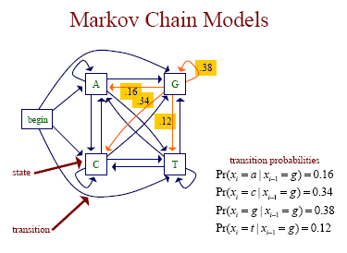
Markov Chain Models have conditional probabilities

Slide 14
Markov Chain Models
a Markov chain model is defined by:
a set of states
some states emit symbols
other states (e.g. the begin state) are silent
a set of transitions with associated probabilities
the transitions emanating from a given state define a distribution over the possible next states
the transitions are given as a N*N transition matrix, where N is the number of states

Slide 15
Markov Chain Models
S – observations (i.e., the input to the model)
x₁,…,x_{n} – sequence of observations
Q - states
π₁,…, π_{n} – sequence of states
f=(f₁,…,f_{N})^{T} - initial probability of states
A = (a_{ij}) – transition matrix

Slide 16


Markov Chain Models calculating probabilities
given some sequence x of length L, we can ask how probable the sequence is given our model
for any probabilistic model of sequences, we can write this probability as
key property of a 1st order Markov chain: the probability of each X_{i} depends only on X_{i-1}

Slide 17
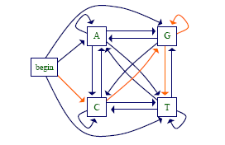
Markov Chain Models
Calculate the probabilty of a sequence X by multiplying the transition probabilities along the associated path through the Markov model
First order: P(cggt) = P(c|begin)P(g|c)P(g|g)P(t|g)

Slide 18
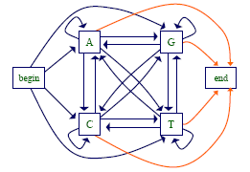
Markov Chain Models
Can also have an end state, allowing the model to represent:
Sequences of different lengths
Preferences for sequences ending with particular symbols

Slide 19

Markov Chain Models
The transition parameters can be denoted by
where
Similarly we can denote the probability of a sequence x as
Where represents the transition from the begin state to x₁
Pr(x₁, x₂, .., x_{n}) =

Slide 20
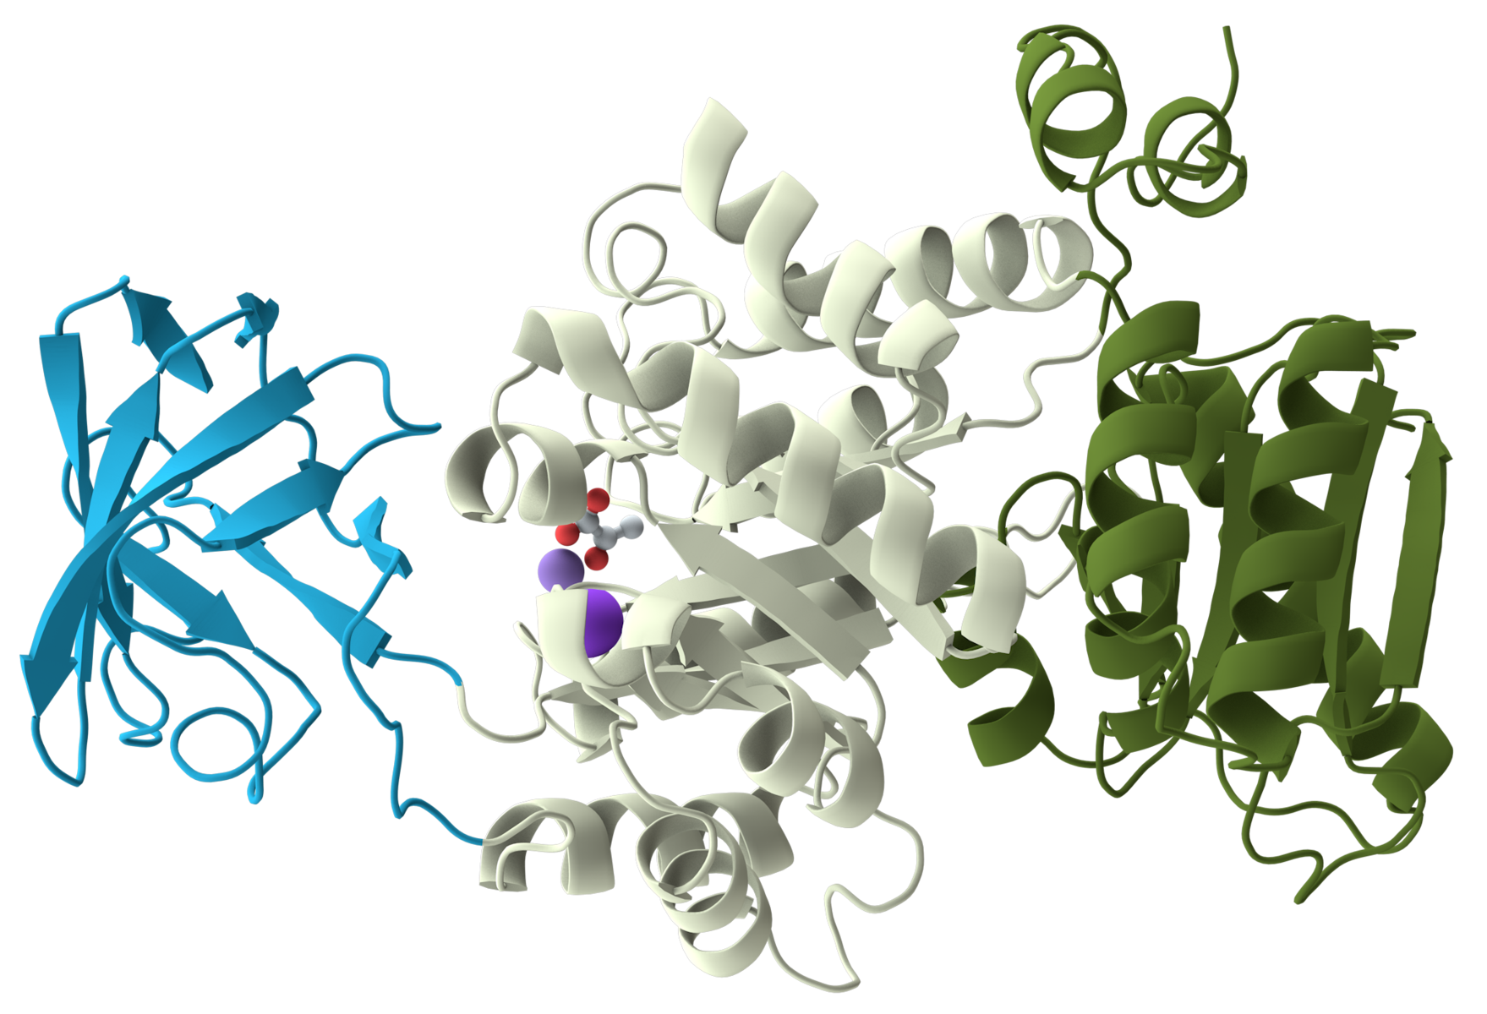
Third Course Assignment Practical Hidden Markov Models
You will construct your own HMM to predict domain/linker structures in protein sequences
The best way to learn about an algorithm is by doing...
D L D L D

Slide 21
Preamble for your HMM practical: Hidden Markov Models (HMMs)
S – observations (i.e., input to the model)
x₁,…,x_{n} – sequence of observations
Q - states
π₁,…, π_{n} – hidden sequence of states
f=(f₁,…,f_{N})^{T} - initial probability of states
A = (a_{ij}) – transition matrix
and now extra
E = (e_{i}(x)) – emission probabilities

Slide 22
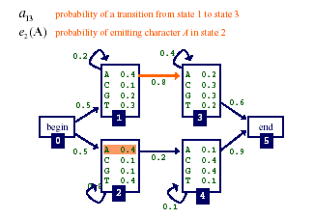
A Simple HMM
A Simple Markov Model
Symbol emitted is coupled to a state; there are only transition probabilities
Symbol emitted is decoupled from the state it is emitted by – this is the hidden aspect

Slide 23
What is the most probable path π of sequence AAC?

Slide 24
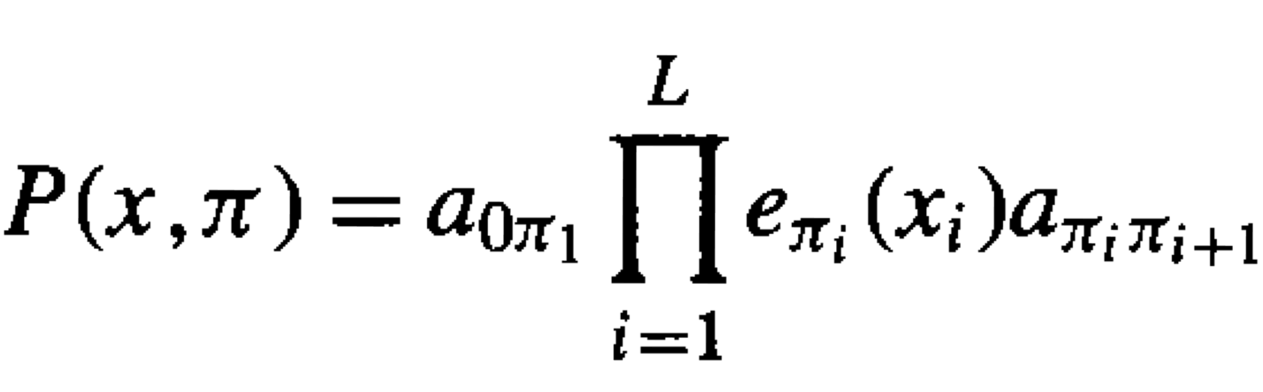
Given a HMM path, what is the score of a sequence generated by taking this path?
Probability that path is taken and sequence generated:
or
(Durbin et al.)
(assuming begin (0) and end (π_{L+1}) states are the only silent states on path)

Slide 25
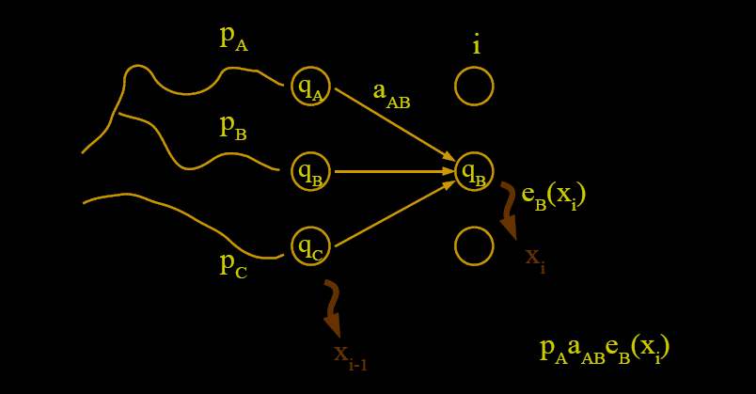
Finding the Most Probable Path: The Viterbi Algorithm
Viterbi – recursive step
What is the probability of the path which ends with q_{A}->q_{B} and emission E_{B}?

Slide 27
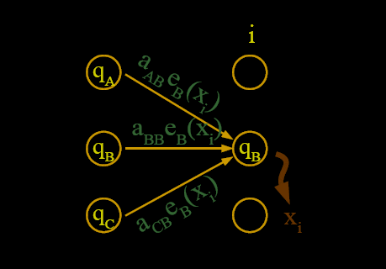
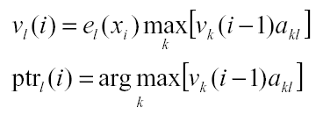
Finding the Most Probable Path: The Viterbi Algorithm
Viterbi – recursive step
What is the most probable path into state B in step i?
Many more than three paths can lead into state q_{a}…
Just as with DP, check all directions you can come from and select the one with the maximal score
If state q_{B} is indexed as l:
,
where transitions are checked between states all possible k and state l (the current state)

Slide 28
Finding the Most Probable Path: The Viterbi Algorithm How to do the bookkeeping
Andrew Viterbi used Manhattan grid model to solve the Decoding problem.
Every choice of π = π₁ … π_{n} corresponds to a distinct path in the graph.
Only valid direction in the graph is eastward.
This graph has N²(n-1) edges, where N is number of states, and n the number of sequence symbols (L) plus the number of silent states

Slide 29
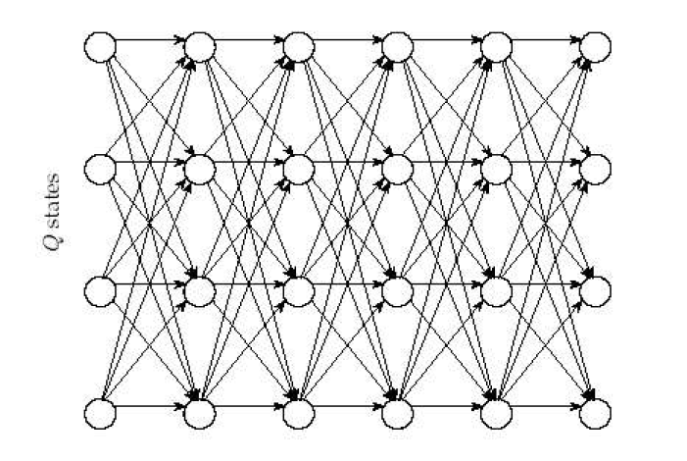
Finding the Most Probable Path: The Viterbi Algorithm
Manhattan grid model
This diagram is also called a trellis. Each column in the trellis shows all HMM states; it is executed from left to right (i.e. ‘eastward’) by going through the sequence of observations.
Execute the recursive formula:
Sequence

Slide 30
Back to Markov Models - Biological Example: Methylation and CpG Islands
CG dinucleotides (called CpG to avoid confusion with C-G base pairs) in nuclear DNA often undergo methylation, where a methyl (CH3) “joins” the Cytosine (C).
Methylated genes are usually underexpressed (‘silencing mark’).
CG dinucleotides are rarer in eukaryotic genomes than expected given the independent probabilities of C, G
In the human genome CpG (CG) is least frequent dinucleotide, because C in CpG is easily methylated and has the tendency to mutate into T afterwards
However, methylation is suppressed around genes in a genome; unmethylated CGs are often found within active gene regions (this is condition and tissue dependent).
As a result, CpG appears more frequently within gene regions: A CpG island is a short stretch of DNA in which the CpG frequency is higher than other regions; they are typically found with higher density around genes (particularly just upstream of Open Reading Frames (ORFs))
http://www.web-books.com/MoBio/Free/Ch7F2.htm

Slide 31
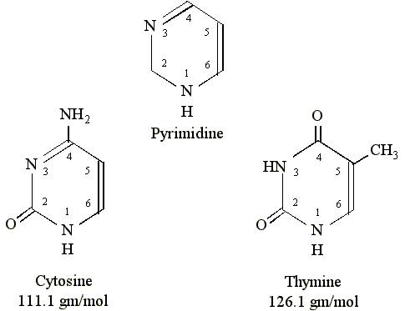
Biological Example: Methylation and CpG Islands
The enzyme methylating the C in CpG is M5C methyltransferase, also called C-5 cytosine-specific DNA methylase or C5 Mtase
It specifically methylates the C-5 carbon of cytosines in DNA to produce C5-methylcytosine
Some methylated cytosines become converted to thymine by deamination (at C-4)
Over evolutionary time scales, the methylated CG sequence will often be converted to the TG sequence (compromising the base pair the C can engage in).
M5C methylation
Sugar of DNA main-chain binds here

Slide 32
Example Application: gene prediction using CpG Islands
CpG islands
Regions upstream of genes are richer in CG dinucleotides than elsewhere – CpG islands
Identifying the CpG islands in a genome is important as it represents useful evidence for finding genes
Could predict CpG islands with Markov chains
one to represent CpG islands
one to represent the rest of the genome
Our example (see Durbin et al. textbook) includes using Maximum likelihood and Bayes’ statistics, and feeding an input sequence to a Markov model (and also an HMM)
See Durbin et al. (course book) Chapter 3: Pp. 46 - 53

Slide 33
Estimating Markov Model Parameters
Given some data (e.g. a set of sequences from CpG islands), how can we determine the probability parameters of our model?
One approach: maximum likelihood estimation
given a set of data D
set the parameters θ to maximize
Pr(D | θ)
i.e. make the data D look likely under the model

Slide 34
Maximum Likelihood Estimation
Suppose we want to estimate the parameters Pr(a), Pr(c), Pr(g), Pr(t)
And we’re given the sequences:
accgcgctta
gcttagtgac
tagccgttac
Then the maximum likelihood estimates for the overall nucleotide probabilities are:
Pr(a) = 6/30 = 0.2 Pr(g) = 7/30 = 0.233
Pr(c) = 9/30 = 0.3 Pr(t) = 8/30 = 0.267
(.. these estimates are just the overall nucleotide frequencies)

Slide 35
Maximum Likelihood Estimation
Suppose instead we saw the following sequences:
gccgcgcttg
gcttggtggc
tggccgttgc
Then the maximum likelihood estimates are:
Pr(a) = 0/30 = 0 Pr(g) = 13/30 = 0.433
Pr(c) = 9/30 = 0.3 Pr(t) = 8/30 = 0.267
Do we really want to set Pr(a) to zero?
(the six ‘a’s are now ‘g’)

Slide 36
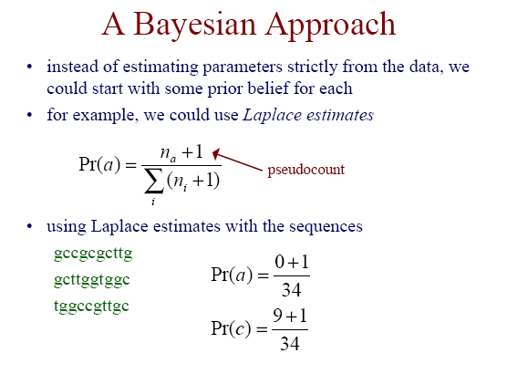

Slide 37
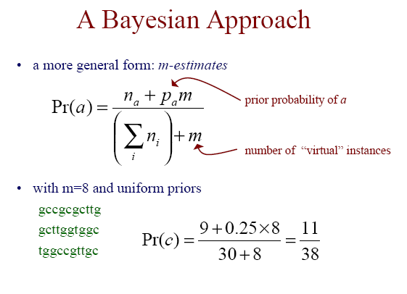

Slide 38
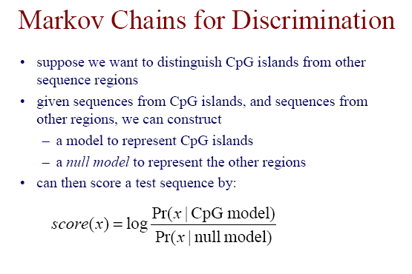
See Durbin et al. (course book) Chapter 3: Pp. 46 - 53

Slide 39
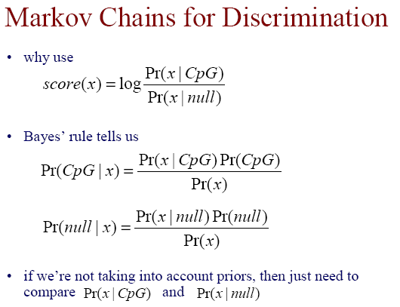
prior
posterior

Slide 40
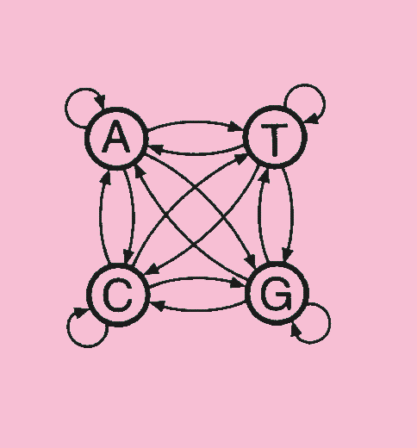
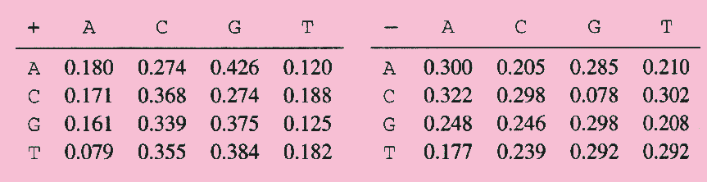
CpG Islands
We construct a Markov chain for CpG rich (+) and another for CpG poor (-) regions
Using maximum likelihood estimates from 60K nucleotide training sets, we get two models
These dinucleotide frequency data are derived from genome sequences
Example taken from Chapter 3 in Durbin et al.’s course book

Slide 41
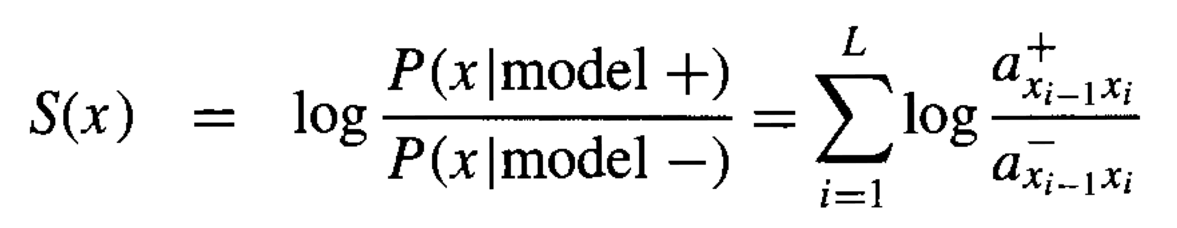
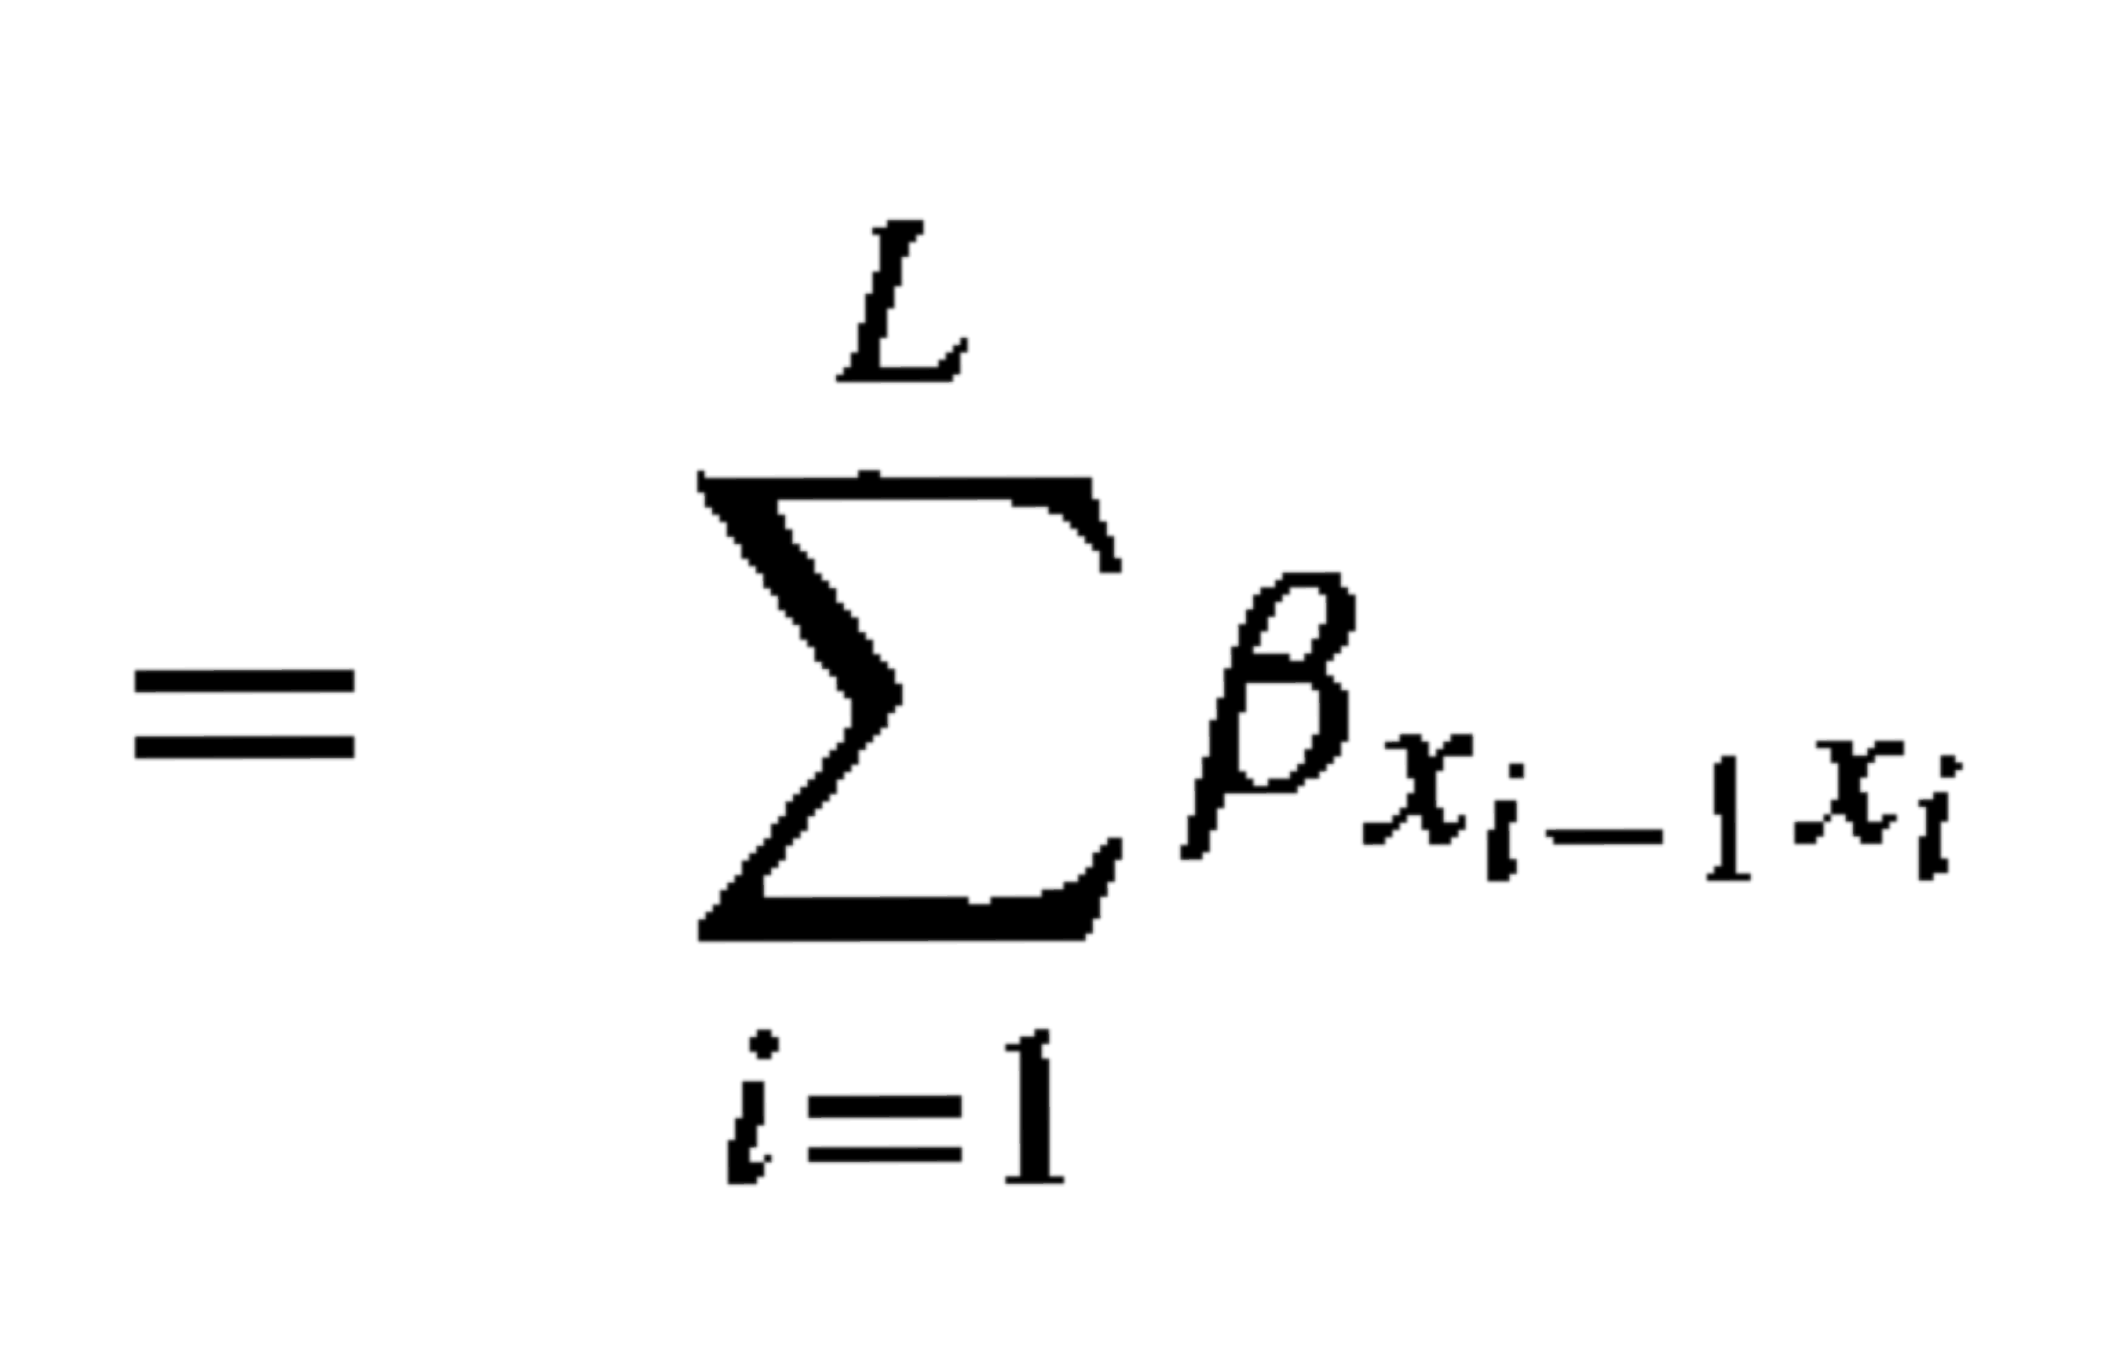
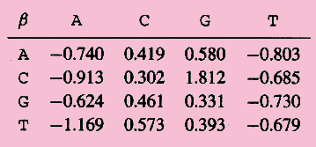
Ratio Test for CpC islands
Given a sequence X₁,…,X_{n} we compute the likelihood ratio
=
2
2
Transition probabilities based on log₂ values

Slide 42
Finding CpG islands: sequence fragment size
Simple Minded approach:
Pick a window of size N (N = 100, for example)
Compute log-ratio for the sequence in the window, and classify based on that
Problems:
How do we select N? CpG islands have varying lengths…
What do we do when the window intersects the boundary of a CpG island? We want to be able to jump from ‘+’ to ‘-’..

Slide 43
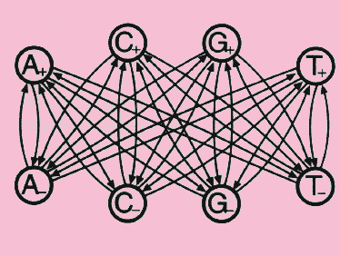
Alternative Approach: HMM model
Build a single model that include “+” states and “-” states, so model can switch between CpG (+) and ‘normal’ (-)
A state ‘remembers’ last nucleotide and the type of region
A transition from a “-” state to a “+” corresponds to the start of a CpG island
‘+’
In this HMM model you are not sure anymore in which state the sequence is when you observe an ‘A’… (can be in ‘+’ or ‘-’).
Note that the transitions among ‘+’ and among ‘-’ states are left out for clarity in the figure.
‘-’

Slide 44
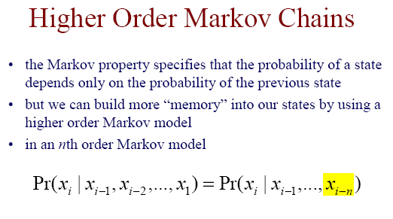

Slide 45
Higher Order Markov Chains
An n^{th} order Markov chain over some alphabet is equivalent to a first order Markov chain over the alphabet of n-tuples
Example: a 2nd order Markov model for DNA can be treated as a 1st order Markov model over alphabet:
AA, AC, AG, AT, CA, CC, CG, CT, GA, GC, GG, GT, TA, TC, TG, and TT (i.e. all possible dinucleotides)

Slide 46
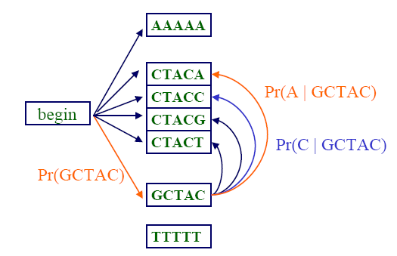
A Fifth Order Markov Chain
A 5th order Markov chain over a 4-letter alphabet (DNA) is equivalent to a first order Markov chain over the alphabet of 5-tuples

Slide 47
Inhomogeneous Markov Chains
In the Markov chain models we have considered so far, the probabilities do not depend on where we are in a given sequence
In an inhomogeneous Markov model, we can have different distributions at different positions in the sequence
Consider modeling codons in protein coding regions

Slide 48
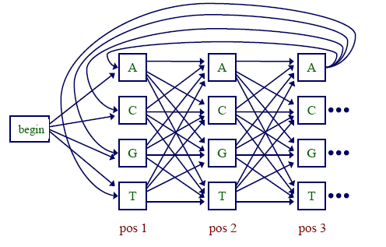
Inhomogeneous Markov Chains
The probabilty of reaching the ‘A’ state may differ at position 1, 2 or 3, etc.

Slide 49
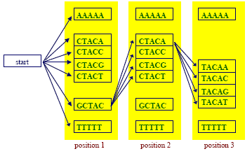
A Fifth Order Inhomogeneous Markov Chain

Slide 50
Selecting the Order of a Markov Chain Model
Higher order models remember more “history”
Additional history can have predictive value
Example:
– predict the next word in this sentence fragment “…finish __” (up, it, first, last, …?)
– now predict it given more history
“Fast guys finish __”

Slide 51
Selecting the Order of a Markov Chain Model (cnt.)
However, the number of parameters we need to estimate grows exponentially with the order, so we need a large data set
– for modeling DNA we need parameters for an n^{th} order model, with n ≥ 5 normally
The higher the order, the less reliable we can expect our parameter estimates to be
– estimating the parameters of a 2nd order homogenous Markov chain from the complete genome of E. Coli, we would see each word > 72,000 times on average
– estimating the parameters of an 8th order chain, we would see each word ~ 5 times on average
This means there is a trade-off between the advantage of more memory with higher orders and the disadvantage of less reliable parameter estimation
Trade-off can be addressed using an Interpolated Markov Model (IMM)

Slide 52
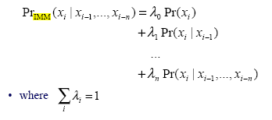
Interpolated Markov Models (IMM)
The IMM idea: manage this trade-off by interpolating among models of various orders
Simple linear interpolation (mixing orders):

Slide 53
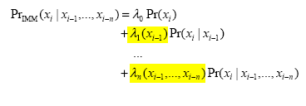
Interpolated Markov Models (IMM)
We can make the weights depend on the history
– for a given order, we may have significantly more data to estimate some words as compared to others
General linear interpolation

Slide 54
Example: Gene Finding (again) Search by Content
Encoding a protein affects the statistical properties of a DNA sequence
some amino acids are used more frequently than others (Leu more popular than Trp)
different numbers of codons for different amino acids (Leu has 6, Trp has 1)
for a given amino acid, usually one codon is used more frequently than others
The latter is termed codon preference
Codon preferences vary by species

Slide 55
Codon Preference in E. Coli
AA codon /100
----------------------
Gly GGG 1.89
Gly GGA 0.44
Gly GGU 52.99
Gly GGC 34.55
Glu GAG 15.68
Glu GAA 57.20
Asp GAU 21.63
Asp GAC 43.26
Codon biases not only exist between various synonymous codons (coding for the same amino acid), but can also vary dramatically between organisms.
Some bacteria even have a different codon table, and so some of their codons may encode other amino acids than in higher organisms

Slide 56
Search by gene content
Common way to search by content
build Markov models of coding & noncoding regions
apply models to ORFs (Open Reading Frames) or fixed-sized windows of sequence
GeneMark [Borodovsky et al.]
popular system for identifying genes in bacterial (= prokaryotic) genomes
uses 5th order inhomogenous Markov chain models
Will be used here as a base model to compare performance of the GLIMMER method that will be explained in some detail (later slides)

Slide 57
Prokaryote gene prediction
Gene Prediction using Markov Models
Exploit the fact that oligonucleotide distributions in coding regions are different from those in noncoding regions.
Because a protein-encoding gene is composed of nucleotides in triplets as codons, more effective Markov models are built in sets of three nucleotides, describing nonrandom distributions of trimers or hexamers, and so on.
The parameters of a Markov model have to be trained using a set of sequences with known gene locations (i.e. coding or non-coding).
Once the parameters of the model are established, it can be used to compute the nonrandom distributions of trimers or hexamers in a new sequence to find regions that are compatible with the statistical profiles in the learning set.

Slide 58
Prokaryote gene prediction
Gene Prediction using Markov Models
Statistical analyses have shown that pairs of codons (or dipeptides at the protein level) tend to correlate. The frequency of six unique nucleotides appearing together in a coding region i is much higher than by random chance.
Therefore, a fifth-order Markov model, which calculates the probability of hexamer bases, can detect nucleotide correlations found in coding regions more accurately and is in fact most often used.
A potential problem of using a fifth-order (or even higher order) Markov chain is that if there are not enough hexamers, which happens in short gene sequences, the method’s efficacy may be limited.

Slide 59
Prokaryote gene prediction by GLIMMER
Gene Prediction using Markov Models
To cope with this limitation, a variable-length interpolated Markov model (IMM), has been developed, called Glimmer.
The IMM method samples the number of sequence patterns for the various orders of the Markov models, with k ranging from 1 to 8 (dimers to ninemers)
It uses a weighting scheme which places less weight on rare k-mers and more weight on more frequent k-mers (for a given order)
The probability of the final model is the sum of probabilities of all weighted k-mers.
In other words, this method has more flexibility in using Markov models depending on the amount of data available. Higher-order models are used when there is a sufficient amount of data and lower-order models are used when the amount of data is smaller.

Slide 60
Prokaryote gene prediction by GLIMMER
GLIMMER (Gene Locator and Interpolated Markov ModelER, www.tigr.org/softlab/glimmer/glimmer.html)
Computation consists of two steps: model building and gene prediction.
Model building involves training by the input sequence, which optimizes the parameters of the model.
Glimmer also has a variant, GlimmerM, for eukaryotic gene prediction (more difficult to predict than bacterial genes).

Slide 61
The GLIMMER System
Salzberg et al., 1998
System for identifying genes in bacterial genomes
Uses 8th order, inhomogeneous, interpolated Markov chain models
The model starts at 8th order (i.e. nonamers) and for calculating the weight l_{n} , it checks whether for a given order n there are sufficient observations to train the model, otherwise it goes to order n-1

Slide 62
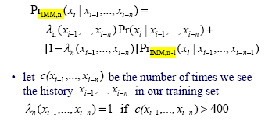
IMMs in GLIMMER
How does GLIMMER determine the values?
First, let us express the IMM probability calculation recursively:

Slide 63
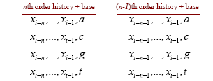
IMMs in GLIMMER
If we see x_{i-1}… x_{i-n} more than 400 times, we use it to the full
If we haven’t seen x_{i-1}… x_{i-n} more than 400 times, then compare n^{th} order and (n-1)^{th} order history::
..sequence goes from left to right here…
• Use a statistical test ( χ²) to get a value d (0 < d < 1) indicating confidence that the distributions represented by the two sets of counts (n^{th} vs. (n-1)^{th} order) are different
[χ2 = ((O - E)²/E)]. A value of d ≥ 0.5 is taken to indicate that the distributions are sufficiently different (so n^{th} order is used).

Slide 64
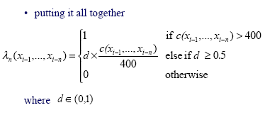
IMMs in GLIMMER
use only n^{th} order
weigh in n-order model based on χ² score when comparing n^{th}-order with n-1th-order Markov model (preceding slide)
.. if n-order MCM is similar to n-1-order, then forget about n-order model and use the smaller (n-1) order to capture more observations.

Slide 65
The GLIMMER method versus 5th order Markov model (GeneMark) as reference model
Evaluation:
8th order IMM compared against 5th order Markov model to show improvement
Trained on 1168 genes (ORFs really)
Tested on 1717 annotated (more or less known) genes

Slide 66
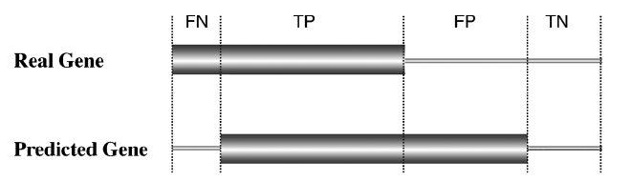

Prokaryote gene prediction - prediction success
FN – false negative, TP – true positive, FP – false positive, TN – true negative
Sensitivity: Sn = TP/(TP + FN)
Specificity Sp = TN/(TN + FP)
PPV: PPV = TP/(TP + FP) -- Positive Predictive Value
Matthews correlation:

Slide 67
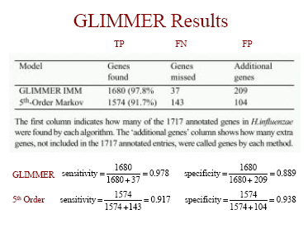
GLIMMER results
PPV
PPV

Slide 68
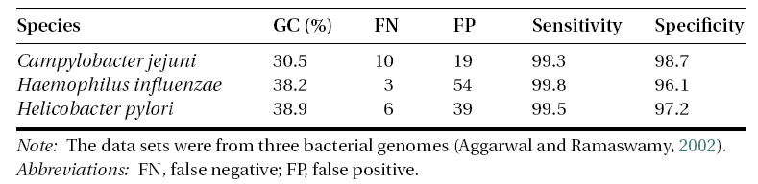
GLIMMER results

Slide 69
Further refinement of bacterial gene prediction methods
Background text
The methods shown on preceding slides have been shown to be reasonably successful in finding genes in a genome. The common problem is imprecise prediction of translation initiation sites because of inefficient identification of ribosomal binding sites. This problem can be remedied by identifying the ribosomal binding site associated with a start codon. A number of algorithms have been developed solely for this purpose.
RBSfinder is one such algorithm. RBSfinder (ftp://ftp.tigr.org/pub/software/RBSfinder/) is a UNIX program that uses the prediction output from Glimmer and searches for the Shine–Delgarno sequences in the vicinity of predicted start sites. If a high-scoring site is found by the intrinsic probabilistic model, a start codon is confirmed; otherwise the program moves to other putative translation start sites and repeats the process.

Slide 70
Further refinement of bacterial gene prediction methods?
Background text
GLIMMER: 8th order IMM
RBSfinder = GLIMMER + finding Shine–Delgarno sequence (RBS)
Question: How about combining this with CpG island prediction?
Could all this be combined in a single Markov model?

Slide 71
Wrapping up
Conditional probabilities and Bayesian statistics primer
Markov chain models
Transition probabilities
Preamble: Hidden Markov models (HMMs)
Transition probabilities and emission probabilities
HMMs: Finding the most probable (optimal) path
The Viterbi algorithm
Markov Model example: CpG prediction
Maximum likelihood with pseudo-counting, Markov approach and HMM approach
Higher Order, Inhomogeneous and Interpolated Markov Models
Example of 8th-order interpolated Markov Model (IMM) for bacterial gene prediction: Glimmer

Slide 72
References
Seminal review by Lawrence R. Rabiner (1989)
bioalgorithms.info
Wikipedia
Course book Biological Sequence Analysis
Book Understanding Bioinformatics
Biological Sequence Analysis : Probabilistic Models of Proteins and Nucleic Acids by Richard Durbin, Sean R. Eddy, Anders Krogh, Graeme Mitchison, Cambridge University Press, ISBN 0521 62971 3 Pbk

Slide 73
APPENDIX
A next slides comprise some biological background information in prokaryotic genetics, including how this type of information can be used to predict coding genes

Slide 74
Prokaryote gene
Background text
Prokaryotes, which include bacteria and Archaea, have relatively small genomes with sizes ranging from 0.5 to 10Mbp (1Mbp=10⁶ bp).
The gene density in prokaryotic genomes is high, with more than 90% of a genome sequence containing coding sequence.
There are very few repetitive sequences. Each prokaryotic gene is composed of a single contiguous stretch of ORF coding for a single protein or RNA with no interruptions within a gene (no splicing).

Slide 75
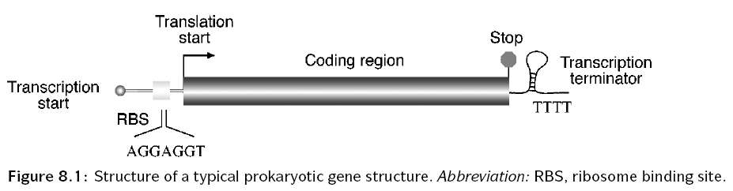
Prokaryote gene
Background text
The majority of genes have a start codon ATG (or AUG in mRNA) coding for methionine. Occasionally, GTG and TTG are used as alternative start codons, both also coding for methionine.
Because there may be multiple ATG, GTG, or TTG codons in a frame, the presence of these codons at the beginning of the frame does not necessarily give a clear indication of the translation initiation site.
To help gene identification, other features associated with translation are used: One such feature is the ribosomal binding site (RBS) , also called the Shine-Delgarno sequence, a stretch of purine-rich sequence complementary to 16S rRNA in the ribosome. It is located immediately downstream of the transcription initiation site and slightly upstream of the translation start codon. In many bacteria, it has a consensus motif of AGGAGGT. Identification of the ribosome binding site can help locate the start codon.

Slide 76
Prokaryote gene
Background text
At the end of the protein coding region is a stop codon that causes translation to stop. There are three possible stop codons, identification of which is straightforward.
Many prokaryotic genes are transcribed together as one operon. The end of the operon is characterized by a transcription termination signal called rho-independent terminator. The terminator sequence has a distinct stem-loop secondary structure followed by a string of Ts. Identification of the terminator site, in conjunction with promoter site identification, can sometimes help in gene prediction.

Slide 77
Prokaryote gene prediction how to predict an ORF by hand
Background text
Perform conceptual translation in all six possible frames (three frames forward and three frames reverse). Because a stop codon occurs in about every twenty codons by chance in a noncoding region, a frame longer than 30 codons without interruption by stop codons is suggestive of a gene coding region (threshold is normally set even higher at 50 or 60 codons).
The putative frame is further manually confirmed by the presence of other signals such as a start codon and Shine–Delgarno sequence.
After translating the putative ORF into the most likely protein sequence, it may then be used to search against a protein database. Detection of homologs from this search is probably the strongest indicator of a protein-coding frame.

Slide 78
Prokaryote gene prediction how to predict an ORF computationally
Background text
Examine nonrandomness of nucleotide distribution
GC bias: the third position of a codon has a preference to use G or C over A or T in a coding sequence. By plotting the GC composition at this position, regions with values significantly above the random level can be identified, which are indicative of the presence of ORFs. In practice, the statistical patterns are computed for all six possible frames.
Relating to GC bias, the method TESTCODE (implemented in the commercial GCG package) exploits the fact that the third codon nucleotides in a coding region tend to repeat themselves. By plotting the repeating patterns at this position, coding and noncoding regions can be differentiated. The results of the methods GC Bias and TESTCODE are often consistent.
These two early methods are often used in conjunction to confirm the results of each other (next slide).

Slide 79
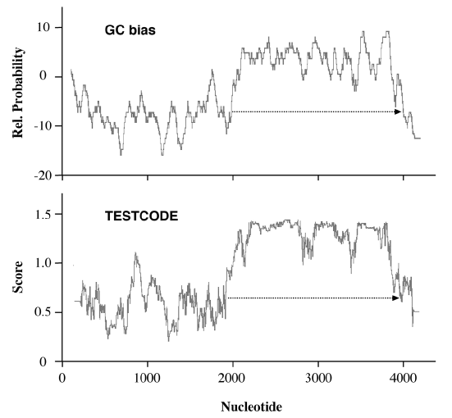
Prokaryote gene prediction
Background text
Coding frame detection of a bacterial gene using either the GC bias or the TESTCODE method. Both result in similar identification of a reading frame (dashed arrows).

